Slide 1

Separation Control with Nanosecond Pulse Driven Dielectric Barrier Discharge Plasma Actuators
Lucio Cota
Advisor: Jesse Little
Department of Aerospace and Mechanical Engineering
University of Arizona
Arizona Space Grant Consortium Symposium
April 12th, 2014
Tucson, AZ

Slide 2
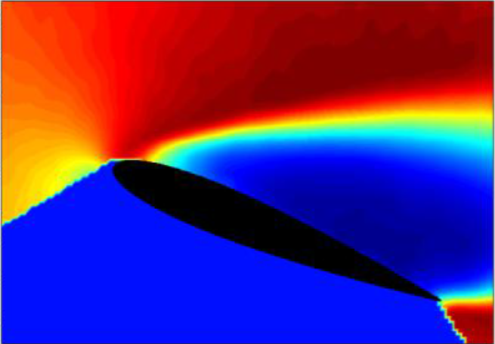
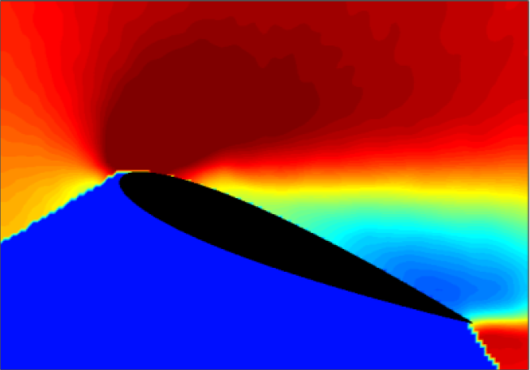
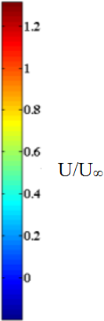
Introduction
Flow Separation in Aerodynamics
Decreases Lift
Increases Drag
Partially Attached Flow via Plasma Actuation
Separated Flow
Caraballo et al, 2014

Slide 3
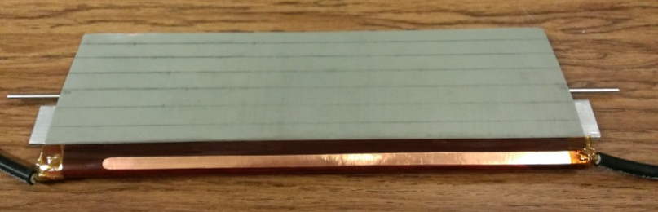
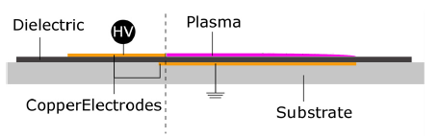
Dielectric Barrier Discharge (DBD) Plasma Actuator
Two Copper Electrodes separated by a dielectric (Kapton tape)
Creates plasma when high voltage is applied (10 kV)

Slide 4
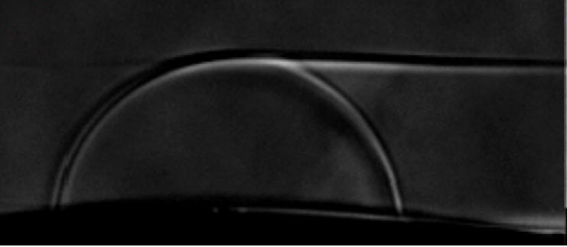
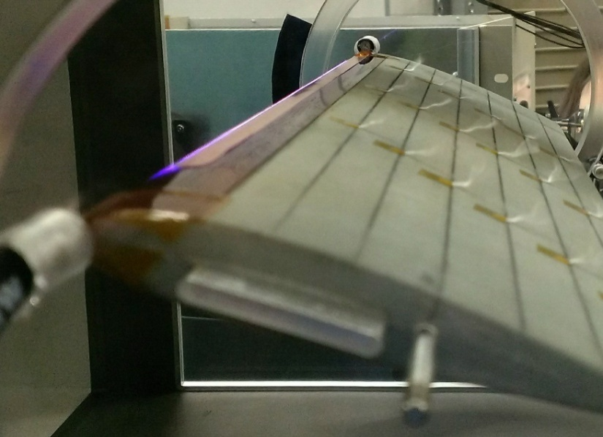
Nanosecond (ns) - DBD
Plasma actuation causes a compression wave due to rapid localized heating
Re-energizes the flow for control separation
Effects are dependent on driving voltage and frequency of pulses

Slide 5

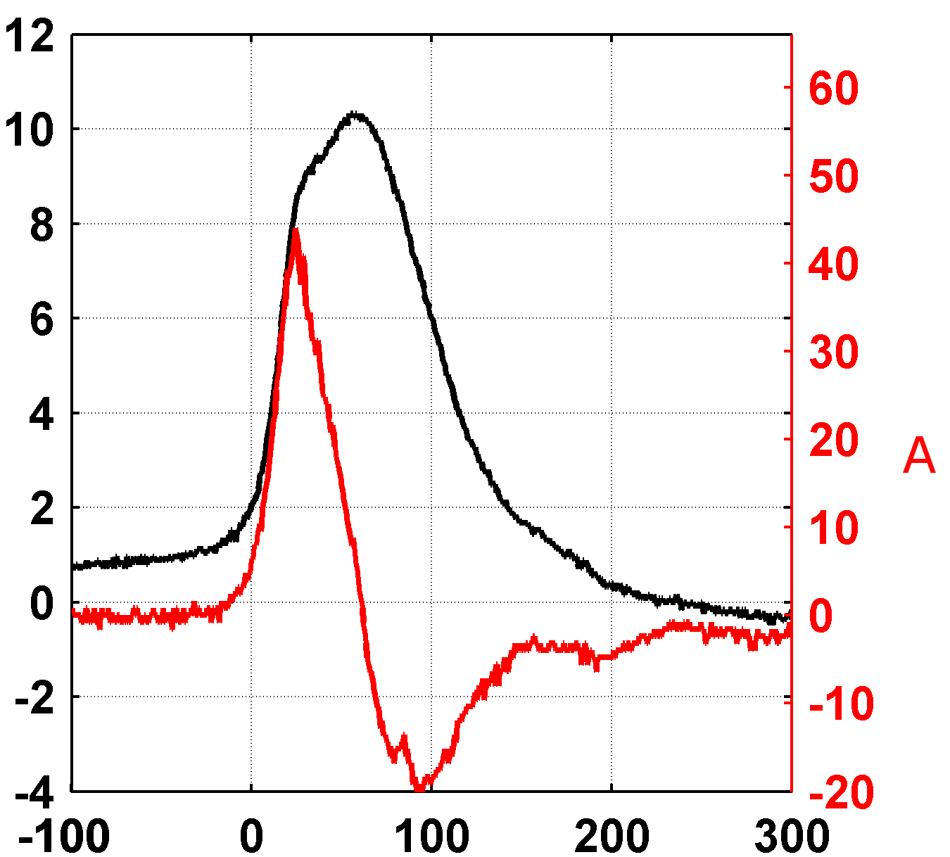
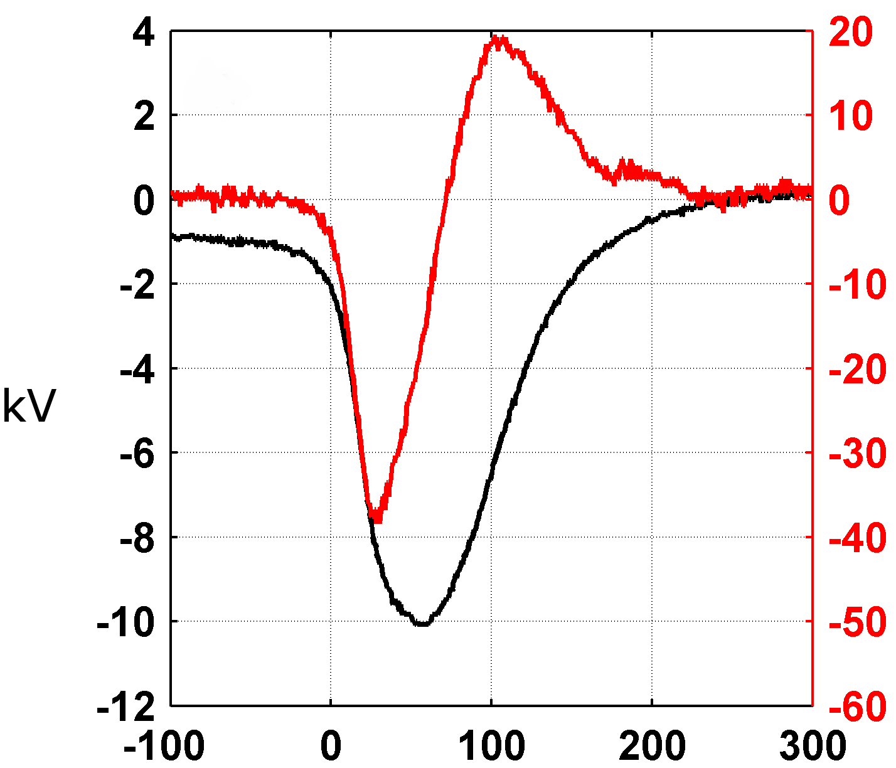
Objectives
Compare positive and negative polarity driving voltages for flow control authority
Previous research shows negative polarity generates stronger pressure waves in quiescent air (Dawson et al, 2013)
Positive
Negative

Slide 6

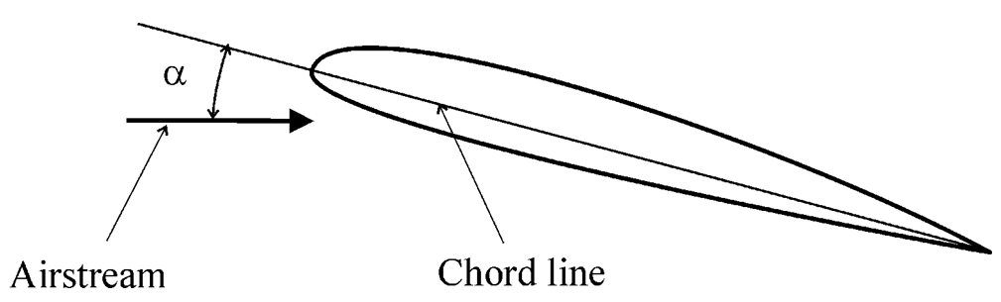
Methods
6
Adjust Parameters to areas of interest
Angle of Attack (α)
  18 degrees
Frequency
  200 to 600 Hz
Measure Static Pressure on test section ceiling

Slide 7
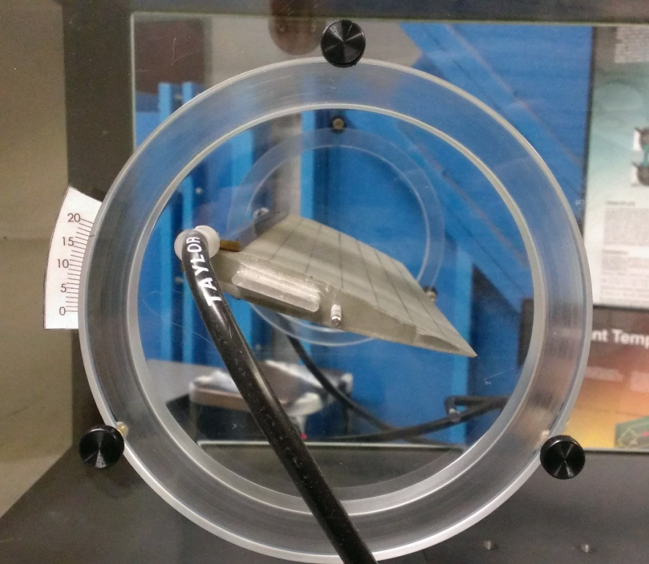
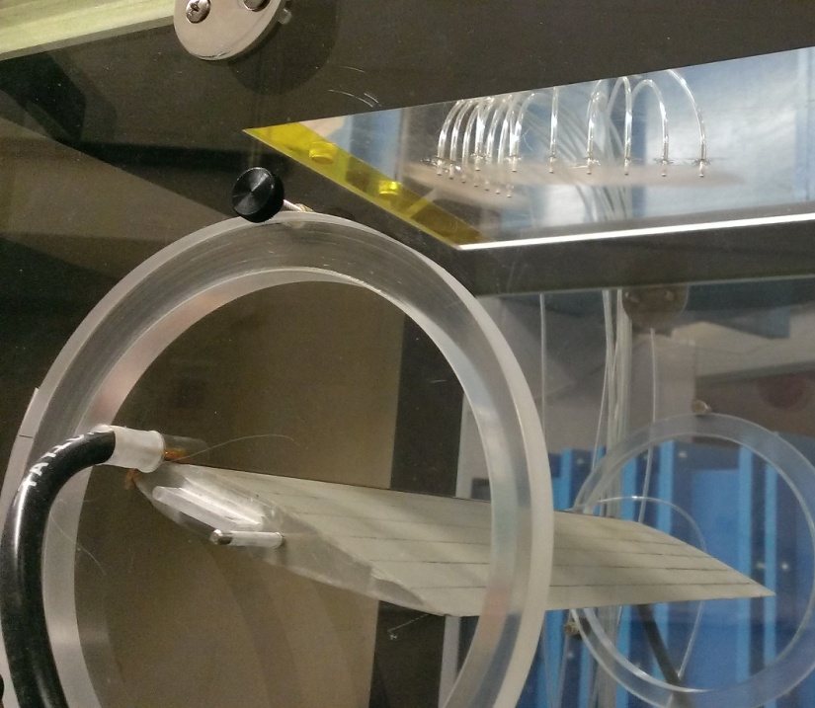
Experimental Facilities
Adjustable wall plugs to control Angle of Attack
Ceiling pressure taps to measure Static Pressure

Slide 8
Experimental Facilities
Adjustable wall plugs to control Angle of Attack
Ceiling pressure taps to measure Static Pressure

Slide 9
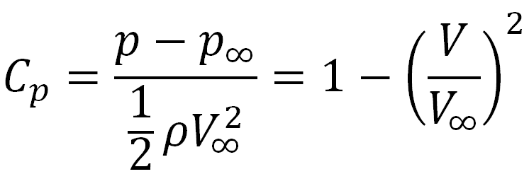
Coefficient of Pressure (C_{p}) Interpretation
Pressure ↓ Velocity ↑
High Velocity Region
Without Plasma
With Plasma
Caraballo et al, 2014

Slide 10

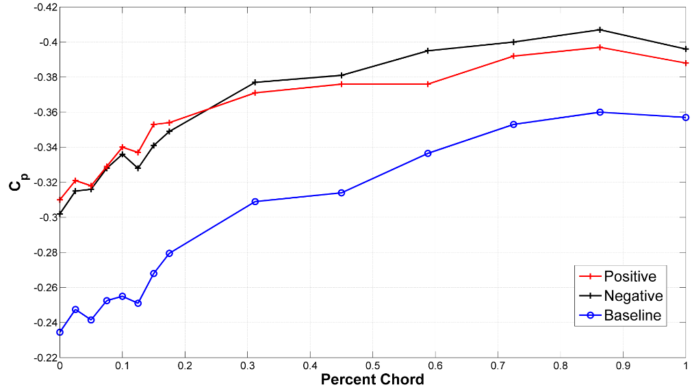
Pressure Distribution: 200 Hz
NACA0015, Re = 1.12 x 10⁵ , α = 18°
- Positive and Negative Polarity are near equal at leading edge

Slide 11
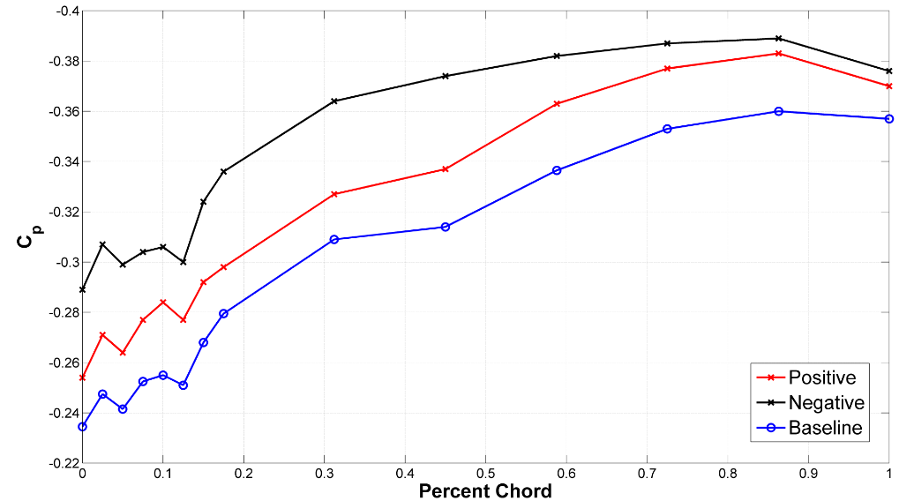
Pressure Distribution: 400 Hz
NACA0015, Re = 1.12 x 10⁵ , α = 18°
- Negative Polarity is more negative than Positive

Slide 12
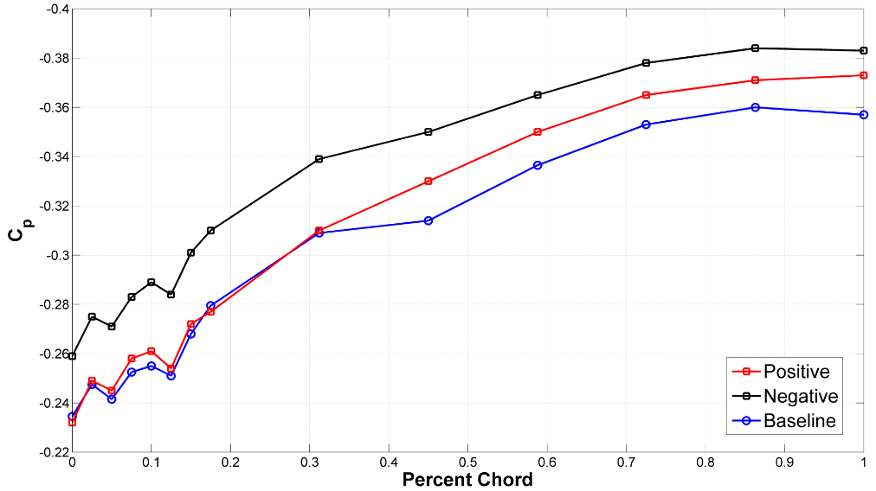
Pressure Distribution: 600 Hz
NACA0015, Re = 1.12 x 10⁵ , α = 18°
- Positive Polarity behaves similar to Baseline, Negative still effective

Slide 13
Summary
200 Hz
Positive discharges and Negative discharges have the same effectiveness at the leading edge
400 Hz
Greatest effect from Negative Discharges
600 Hz
Positive Discharge performs similar to baseline
Effect by Negative Discharges still present

Slide 14
Conclusion
Both Polarities perform best at low frequencies (preferred frequencies exist)
Positive Discharges, at its preferred frequency, has the same influence on Flow Control as Negative Discharges and little to no effect at higher frequencies
Negative Discharges show an effect at all frequencies
Investigation of input voltage may provide more conclusions

Slide 15
Acknowledgements
This Research was Sponsored by
Arizona Space Grant Consortium
Air Force Office of Scientific Research
Special Thanks to
UA Department of Aerospace and Mechanical Engineering
Robyn Dawson
Everyone on the Research Team

Slide 16
Thank You
15

Slide 17
References
Caraballo, E., T. Sullivan, R. You, and J. Little. "Characterization of the Flow Field over a NACA 0015 Airfoil Using Stochastic Estimation Based on Surface Pressure and Hot Film Measurements." AIAA SciTech 13-17.January (2014)
Dawson, Robert, and Jesse Little. "Characterization of Nanosecond Pulse Driven Dielectric Barrier Discharge Plasma Actuators for Aerodynamic Flow Control." Journal of Applied Physics 113.10 (2013): 103302. Print.

Slide 18
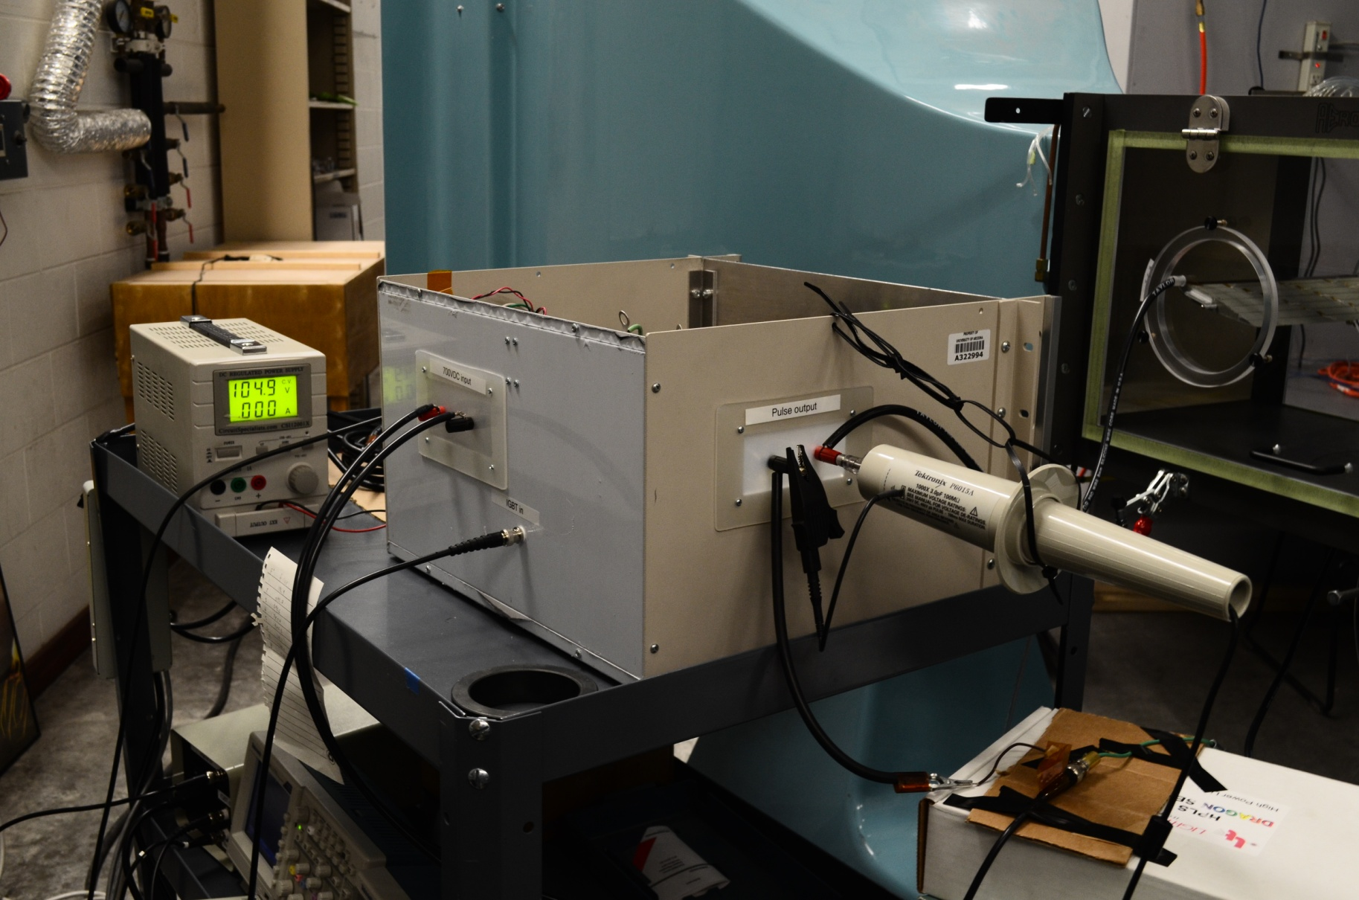
Pulse Generator
17
Generates pulses by magnetic compression

